Slide 1

Prescriptive Analytics to Improve Store Sales Forecast using Explainable-AI
Roland Suparman
Summer 2023

Slide 2
Table of Context
Objective & Problem
Background Information
Problem Statement
Primary Research Questions
Business Justification
Dataset / Plan for Data
Data Sources
Data Description
Key Variables
Approach / Methodology
Exploratory Data Analysis
Data Cleansing
Modeling
Explainability
Observations / Key Takeaways
Conclusion
Project Timeline / Planning

Slide 3
Objective & Problems
Background Information:
Problem Statement: Improve Sales Forecast using Sales Store Data to effectively hyper target customers using Prescriptive analytics from explainable-AI
Primary Research Question: How can stores efficiently improve their sales forecast?
Business Justification: Implementing hyper-targeted prescriptions can help scale and optimize individual stores’ performance. Effective promotional campaigns tailored to specific stores can potentially reduce unnecessary expense.
Brick & Mortar stores are decreasing in popularity compared to online storefronts due to the recent pandemic
Automated and Scalable hyper-targeted insights for improving store-based sales volume are rarely available, leading enterprises to rely on overall sales forecast rather than specific targeting.

Slide 4
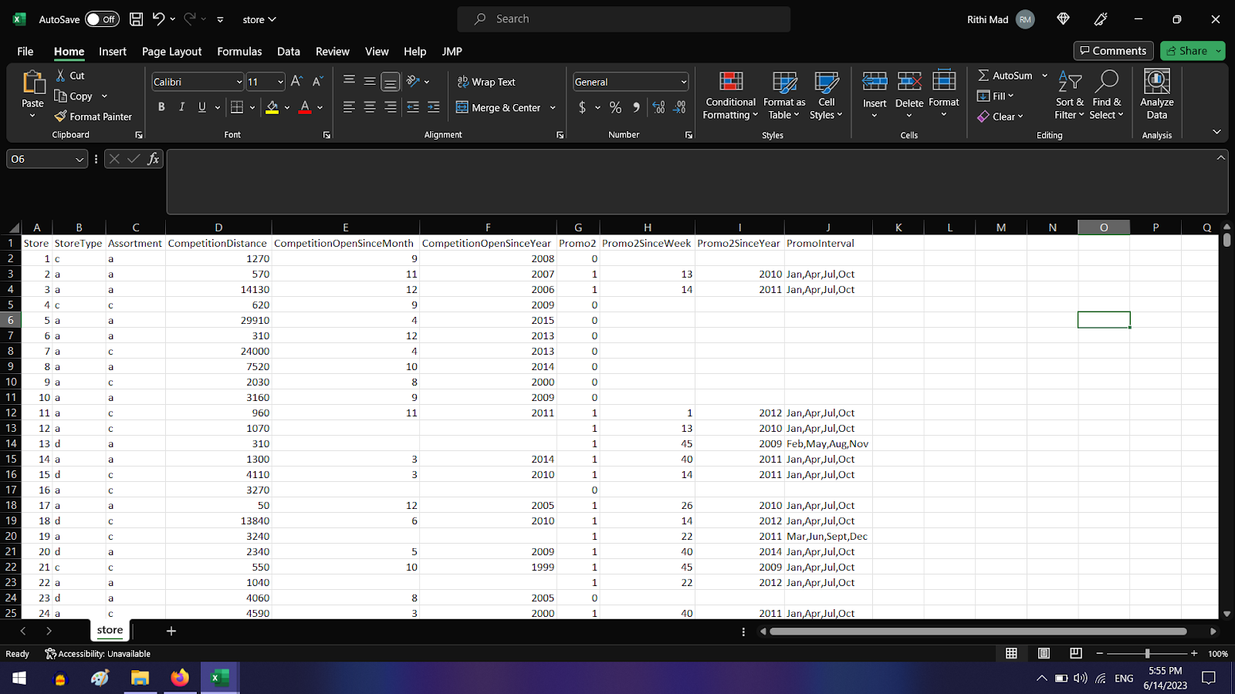
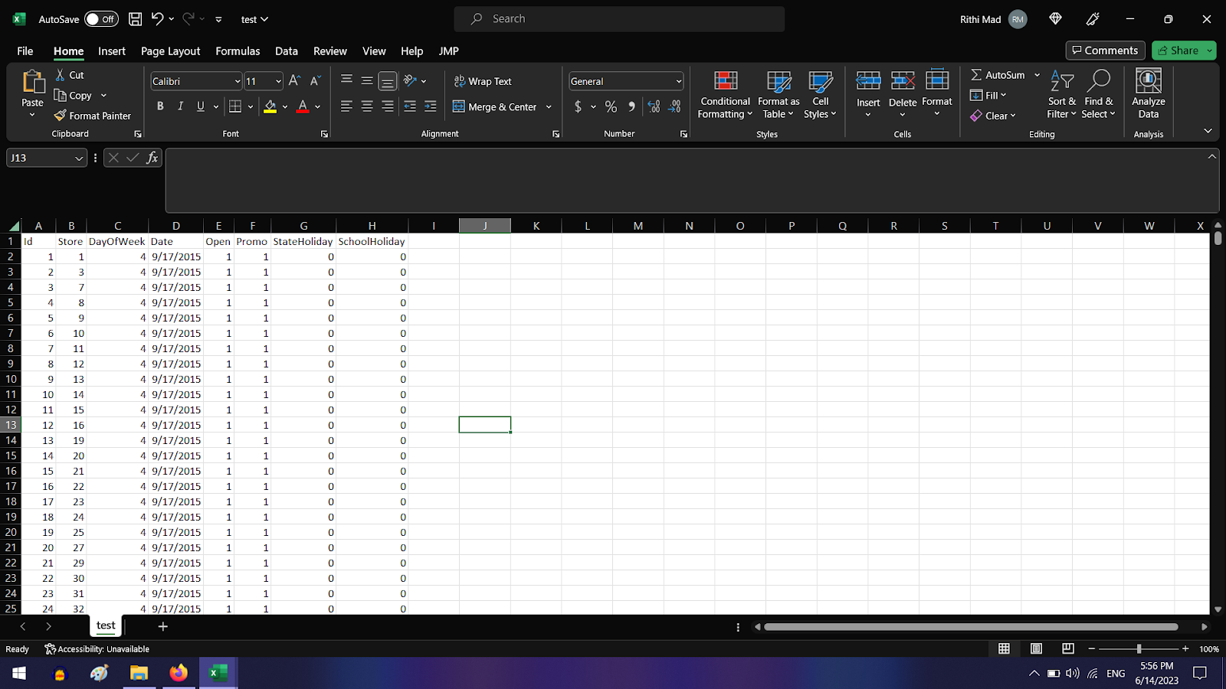
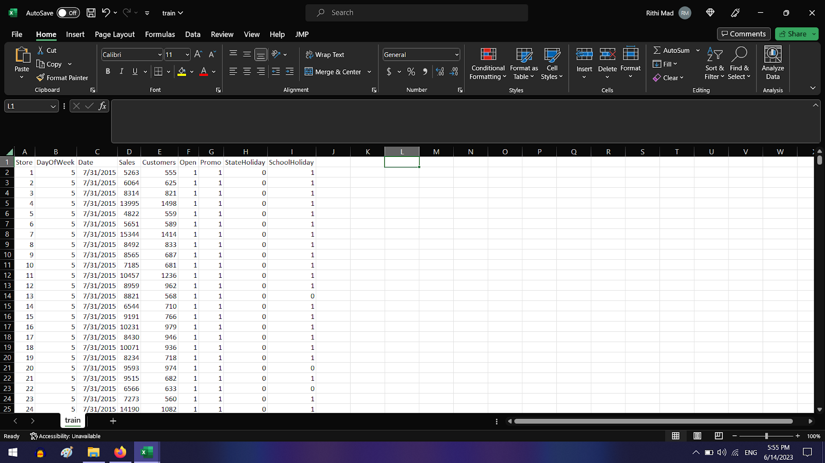
Dataset / Plan for Data
Rossmann Store Sales Data
Test Data (20%)
Train Data (80%)
Key Variables:
Dependent: Sales, Customers
Independent: All others
New Variables: Aggregated columns for regression compatibility
I expect StoreType, Assortment, Holidays and Promo fields to be the most important

Slide 5

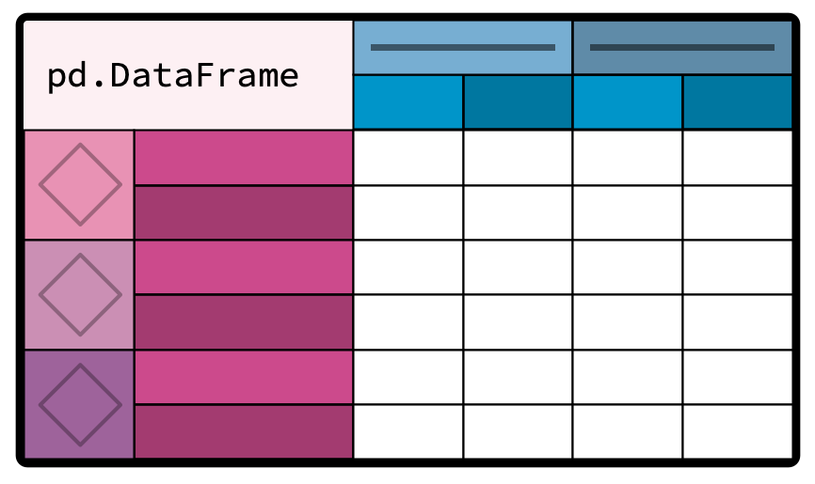




Exploratory Data Analysis
1.02 Million records of Sales Data
8 variables for Sales Data, and 10 variables for Customers Data
1,115 Unique Stores
Time-Series Decomposition from Jan-2013 to Jul-2015
Observed stores that were open with no sales, and stores that were closed on certain dates

Slide 6
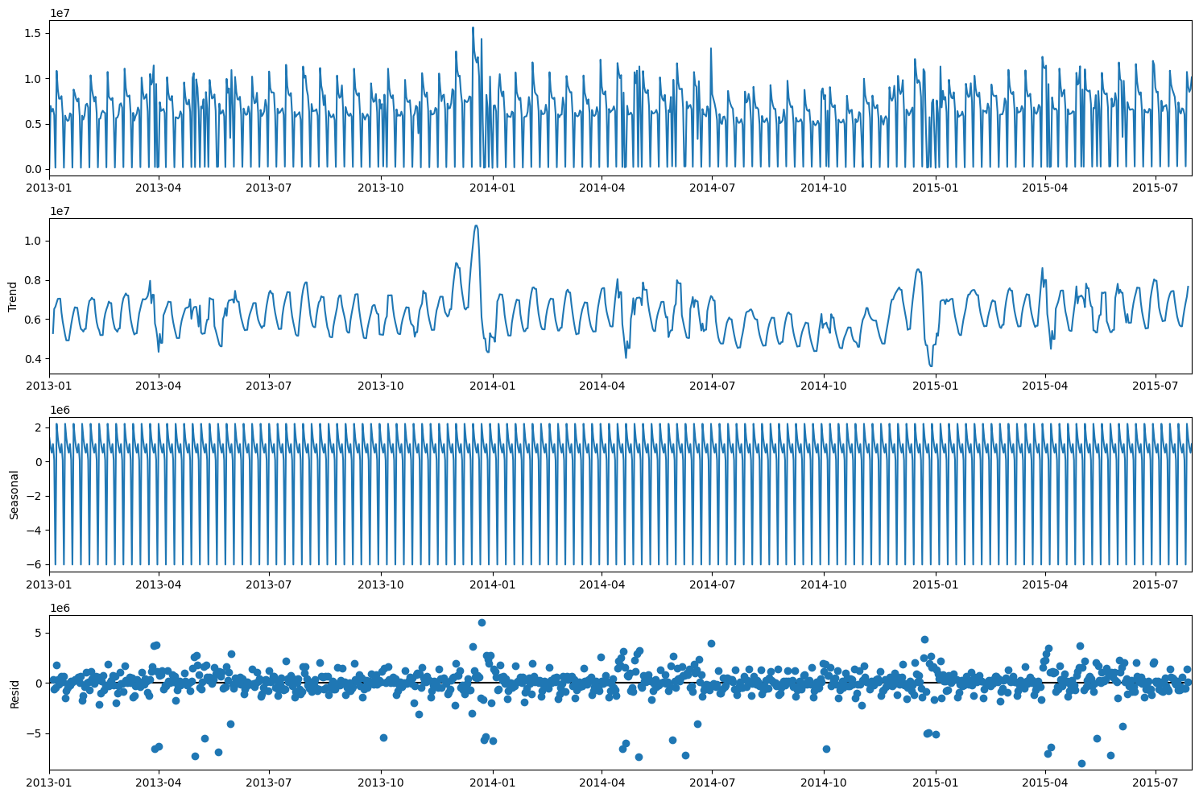
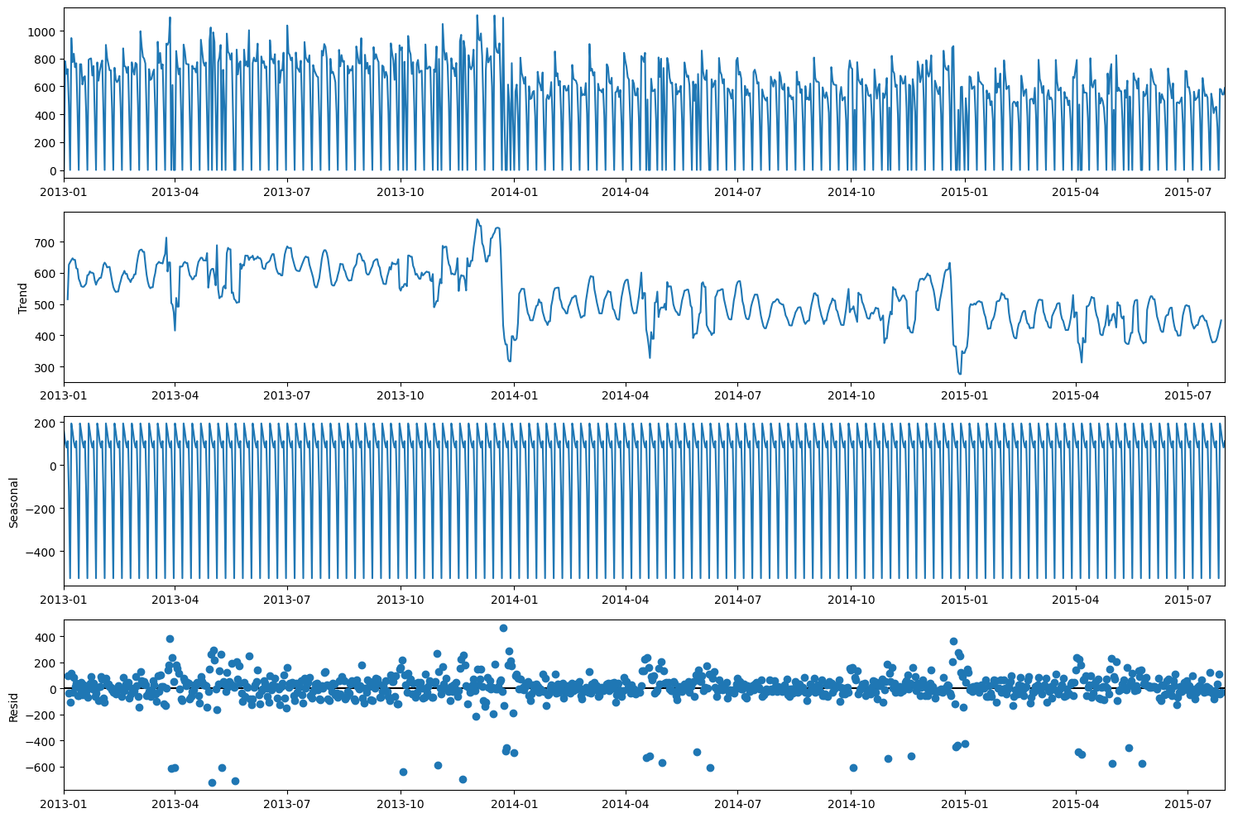
Exploratory Data Analysis
Aggregated Global Sales Data
Sample Store Sales Data
Findings:
Both graphs show weekly seasonality pattern for sales
The sales trend decreases after 2013 in the sample store
Higher sales volume during December time frame

Slide 7
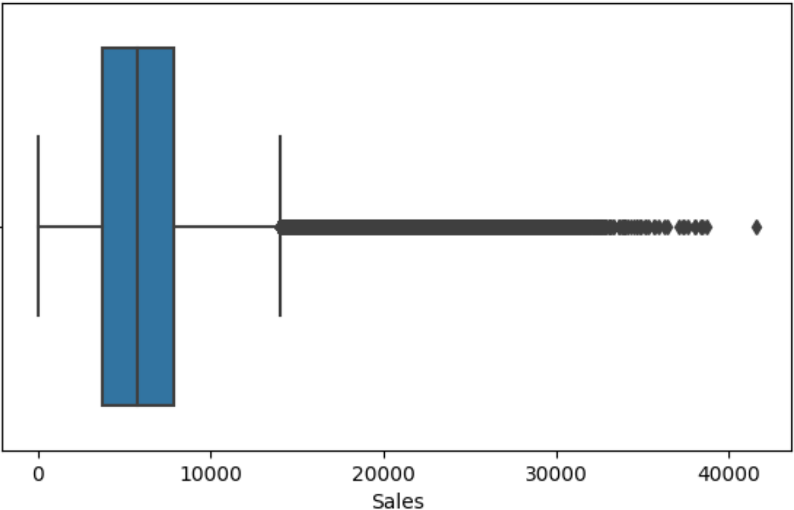
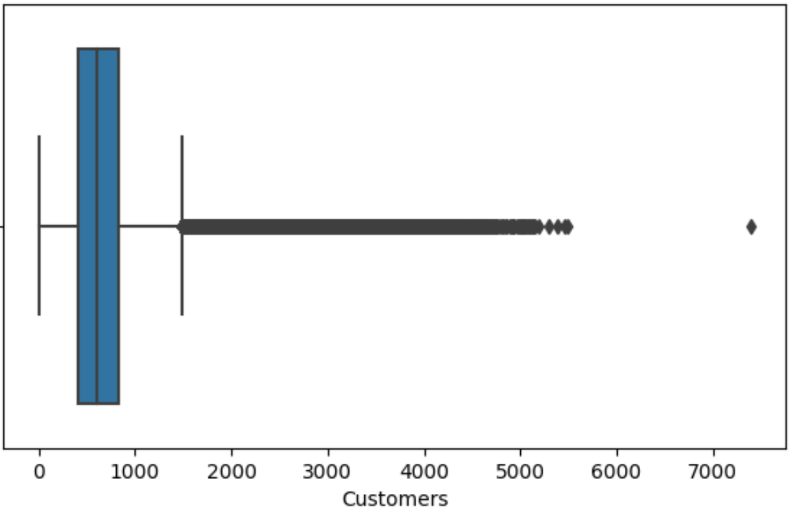
Exploratory Data Analysis
Box Plot of Sales Dataset
Box Plot of Customers Dataset
Findings:
14,000+ are the outliers for Sales data
1,500 are the outliers for Customers data

Slide 8
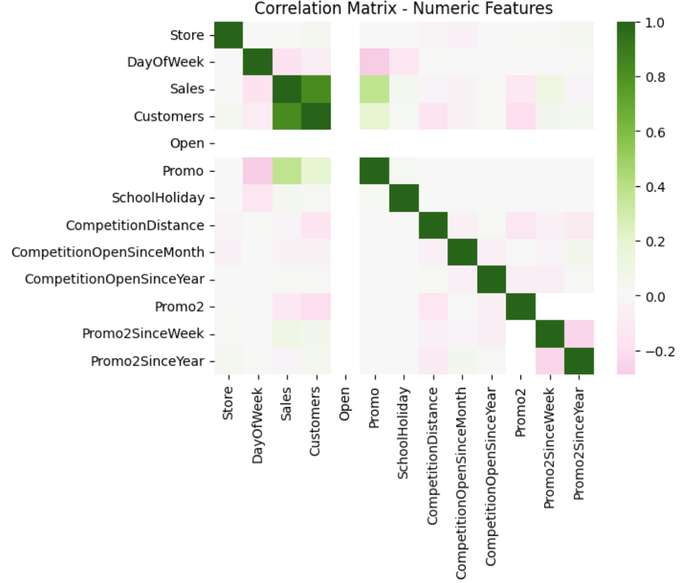
Data Cleaning Process
Correlation Plot for all Features
Steps Taken:
Eliminated Sales records where Stores were Closed + outliers where Stores were Open and No Sales
Merged Sales data with the Individual Store Data based on each Data at unique store level
Sales and Customers are Highly correlated 🡺 Removed Customers during our modeling pipeline to remove redundancy
Eliminated attributes: Date and Store (unique ID)
Used Z-scores on Sales and eliminated records where: Z-Score <= -3, and >= +3 Stdev

Slide 9

80:20 train-test split
Total rows = 830,955
Time-dependent data split
Modeling
Test Result 1
CatBoost
Inbuilt GPU execution capabilities, and no encode categorical features needed
MAE scores 1034 and Avg. Forecast Deviation of 15.80%
Test Result 2
Decision Tree
Created dummy indicator columns for categorical features, and trained the model followed by generating predictions
MAE scores 839.79 and Avg. Forecast Deviation of 12.84% 🡺 Best Result
Test Result 3
Random Forest
Created dummy indicator columns for categorical features, and trained the model followed by generating predictions
MAE scores 839.94 and Avg. Forecast Deviation of 12.84%

Slide 10
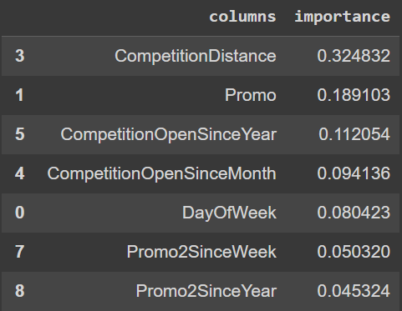
Global Explainability
To understand what the model learnt at a global-level
This summarizes how each feature contributes w.r.t. the training data
Higher values indicate that these features had an increased impact on the prediction as compared to the lower ones.
We observed that all of the above models considered CompetitionDistance and Promo to be significant features which affect the sales prediction provided by the model.

Slide 11
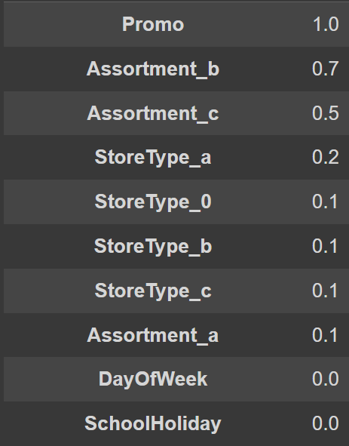
Local Explainability
For building the local prediction level interpretability, we used the interpretML’s DiCE ‘s local feature Importance algorithm.
This summarizes how each feature contributes to an individual prediction.
Higher values indicate that these features had an increased impact on the prediction as compared to the lower ones.
For current store, Promo and Assortments had the highest contribution. Thus, by changing the values for them, we can improve the sales.

Slide 12
Observation / Key Takeaways
Observation
Conclusion
Current Limitations and Future Improvements
Promo and Assortments to have the highest contribution towards the counterfactuals
Importance of Assortment_c > Assortment_a
by changing the values for both (Promo and Assortments), I are able to increase the Sales forecast for the store from $4284 to $11343, which is a 2.6x increase in sales
The regression model gave us sales forecasts, and the explainable AI pipeline will help us get the reason along with the prescriptions to improve identified forecasts.
I realized on average, 1.2x to 2x sales improvement using our alternative prescriptions as the final impact of the solution.
Perform some hyperparameter tuning to find a better model and would try to experiment more on the prescription system.
Integrate the model directly in the app, so that users may call for predictions in real-time
Current model is trained on only limited data, it is exposed to irregularities outside that scope.

Slide 13
Sources
Data Sources:
Source 1: https://www.kaggle.com/c/rossmann-store-sales/ (Dataset Snapshots attached in Appendix)
Source 2 (Backup): https://www.kaggle.com/datasets/rohitsahoo/sales-forecasting
Citations:
Boyapati, Sai Nikhil, and Ramesh Mummidi. “Predicting Sales Using Machine Learning Techniques.” Faculty of Computing, Blekinge Institute of Technology, 371 79 Karlskrona, Sweden, 2020, pp. 23–34.
Chen, Zhaoyu. “Sales Forecast of Walmart on Account of Multivariate Regression and Machine Learning Methods.” School of Artificial Intelligence and Data Science Hebei University of Technology Tianjin, China, EAI, 2022, pp. 1–9.

